Slide 1
ETH Zurich will host ISEC-06 in 2011
Prof. Dr.-Ing. Gerhard Girmscheid
Institute for Construction Engineering and Management
Construction Process and Enterprise Management

Slide 2
Switzerland and the World
Switzerland

Slide 3
Switzerland
Germany
Basel
Zurich
Area: 41’285 km² but only 2’800 km² habitable
Foundation: 1291
Population: 7’740’000
Languages:
German,
French,
Italian,
Rhaeto-Romanic
Currency: Swiss Francs (CHF)
Climate: continental
Winter: cold
Summer: hot and sunny
Lucerne
Berne
Davos
St. Moritz
Jungfrau
Geneva
Matterhorn
Notes:
Foundation: 1291 (“Rütli Schwur”)
Capital: Berne
Total area: 41'285 km² of which only 2800 km² are habitable
Population: 7'739'100
Language: German, French, Italian, Rhaeto-Romanic (64% of the population speak Swiss German)
Religion: 44 % Catholic, 36.6 % Protestant, 19.4 % other
Political System: Federal Republic, direct democracy
Currency: Swiss Francs (1 CHF = 1 US$)
GDP/person: ca. 58'000 US-$
Climate: The climate of Zurich is continental, and temperatures are modified by winds off the Atlantic Ocean. Winters are cold, while summers tend to be hot and sunny

Slide 4
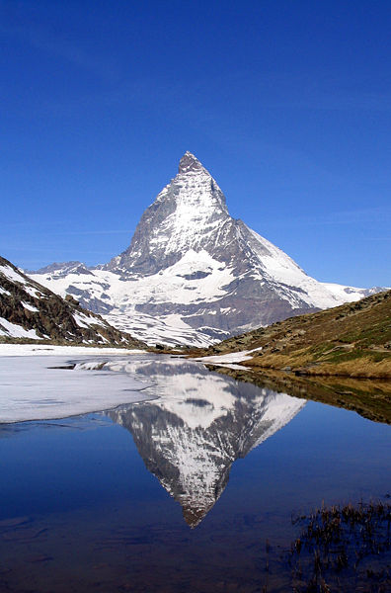
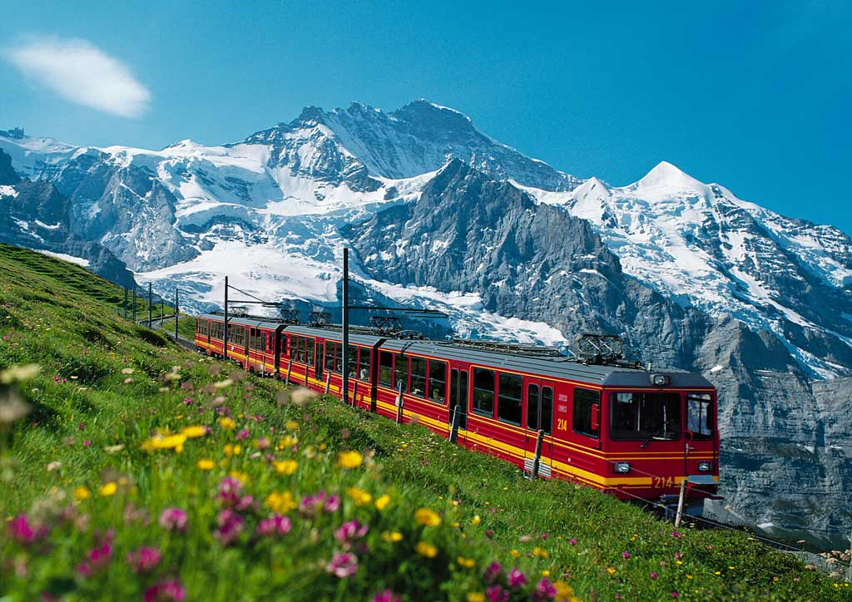
Switzerland has … beautiful high mountains …
Matterhorn
Near Zermatt
4’478 m above sea level
Jungfraujoch – Top of Europe
Europe's highest-altitude railway station at 3’454 m
Eiger (3‘970 m), Mönch (4‘107 m), Jungfrau (4‘158 m)
Notes:
Facts „Matterhorn“
4.478 meters (14,692 ft) above sea level
One of the deadliest peaks in the Alps: 500 alpinists died on it between 1865 – 1995
Iconic emblem of the Swiss Alps and the Alps in general
Facts „Jungfrau“
4,158 meters (13,642 ft) above sea level
World Heritage Site since 2001
Jungfraujoch railway; highest railway station in Europe
Next to Jungfrau: Eiger 3970 m (13,025 ft) and Mönch (German: “monk”) 4107 m (13,474 feet) above sea level

Slide 5
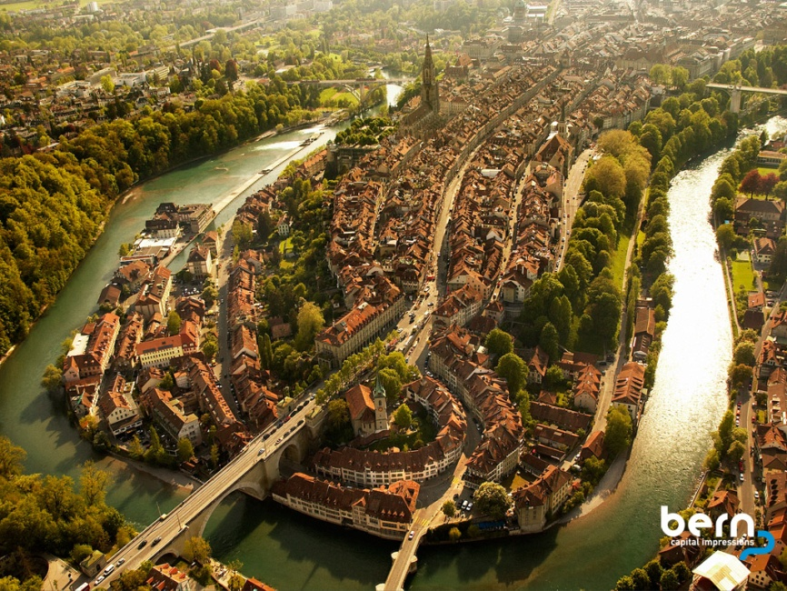
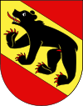
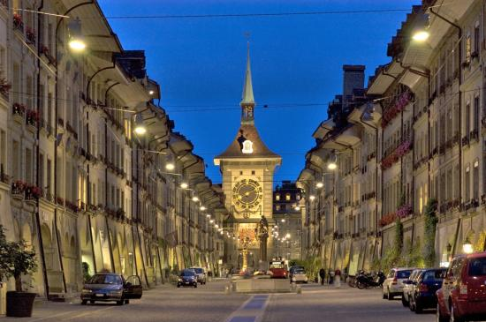
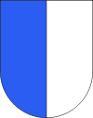
Switzerland has … impressive towns …
Berne
Capital of Switzerland
130’000 inhabitants
Lucerne / Located at Lake Lucerne / 60‘000 inhabitants
Notes:
Facts Berne
Capital of Switzerland
130.000 inhabitants
Fourth most populous city in Switzerland
Historic centre has been featured in the list of UNESCO World Heritage Sites since 1983
Among the world‘s top ten cities for the best quality of life
Facts Lucerne
Founded in 750 AD
About 60’000 inhabitants
Located at the shore of Lake Lucerne (Vierwaldstättersee)
Sight: Chapel Bridge, wooden bridge first built in the 14th century

Slide 6
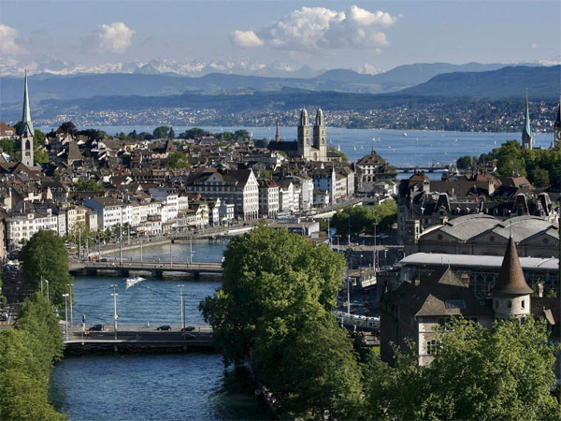
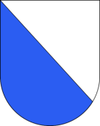
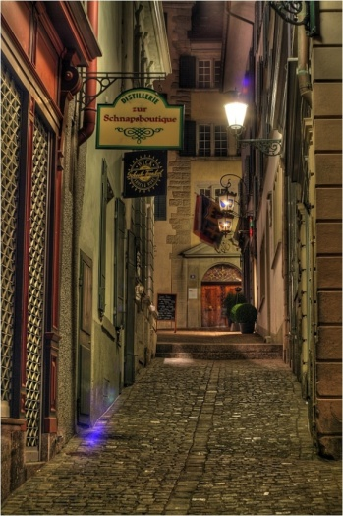
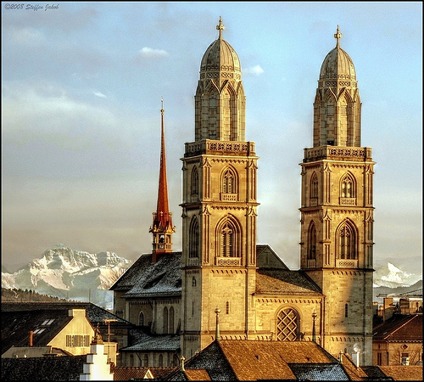
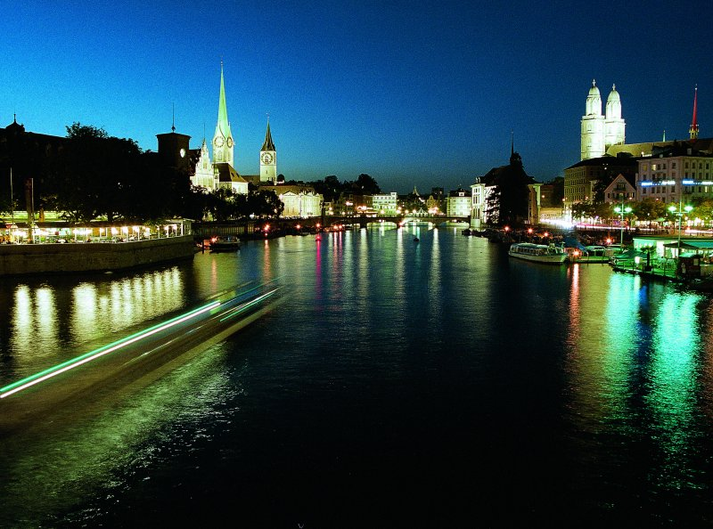
Switzerland has … impressive towns …
Zurich
Largest city of Switzerland
Economic centre
390‘000 inhabitants
Notes:
Facts Zurich
Population: 390’000
Zurich is Switzerland’s largest city
One in 9 Jobs in Switzerland is located in Zurich
80 of 286 banks are headquartered in Zurich
30% foreigners living in Zurich

Slide 7
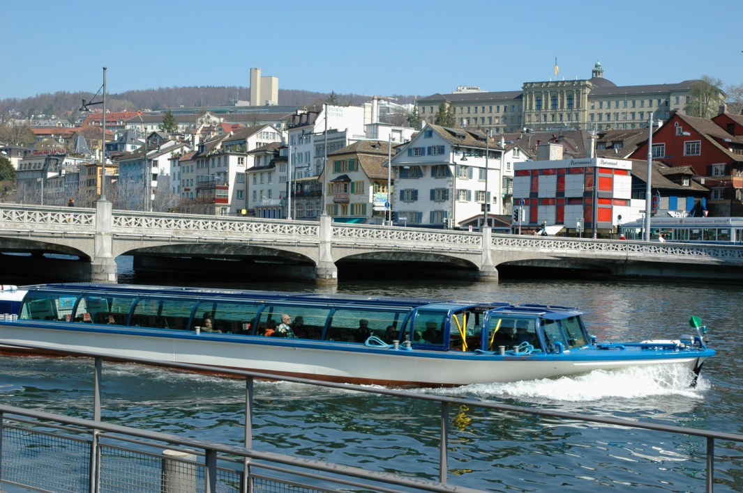
Zurich and the ETH Zurich – Swiss Federal Institute of Technology Zurich

Slide 8
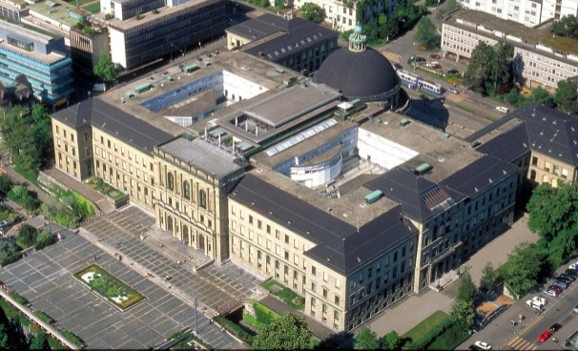
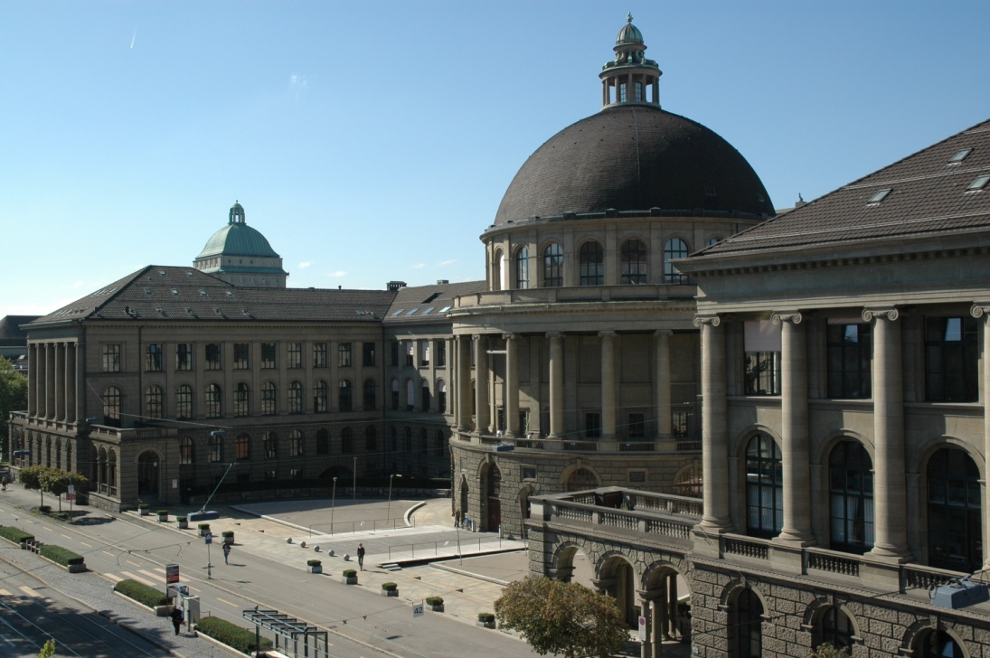
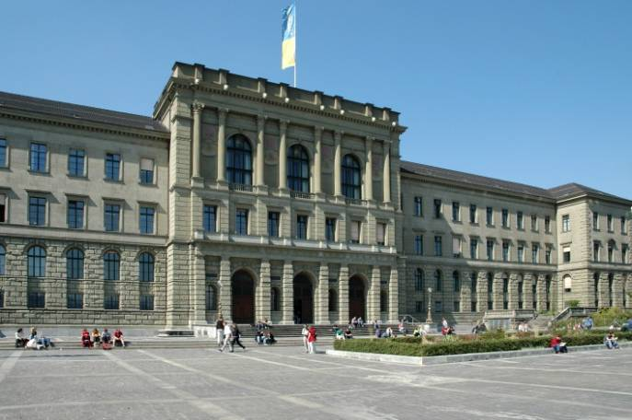
ETH Zurich – Swiss Federal Institute of Technology Zurich
Historic main building of ETH Zurich in the centre of Zurich
Built by Gottfried Semper 1858–1864
Reconstructed by Gustav Gull 1915–1925 (cupola)

Slide 9
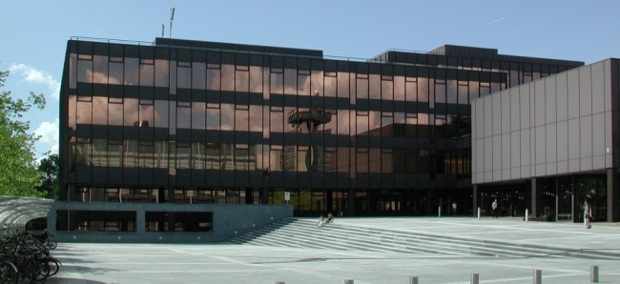
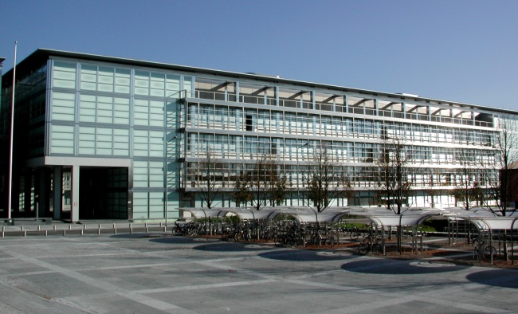
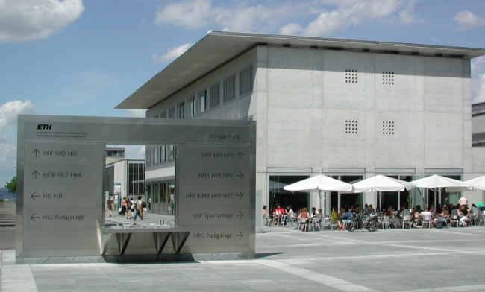
ETH Zurich – Science City at the Hönggerberg
New location on a hill between two districts of Zurich
First buildings built in the 1960s
Further expansion to a campus with student apartments

Slide 10
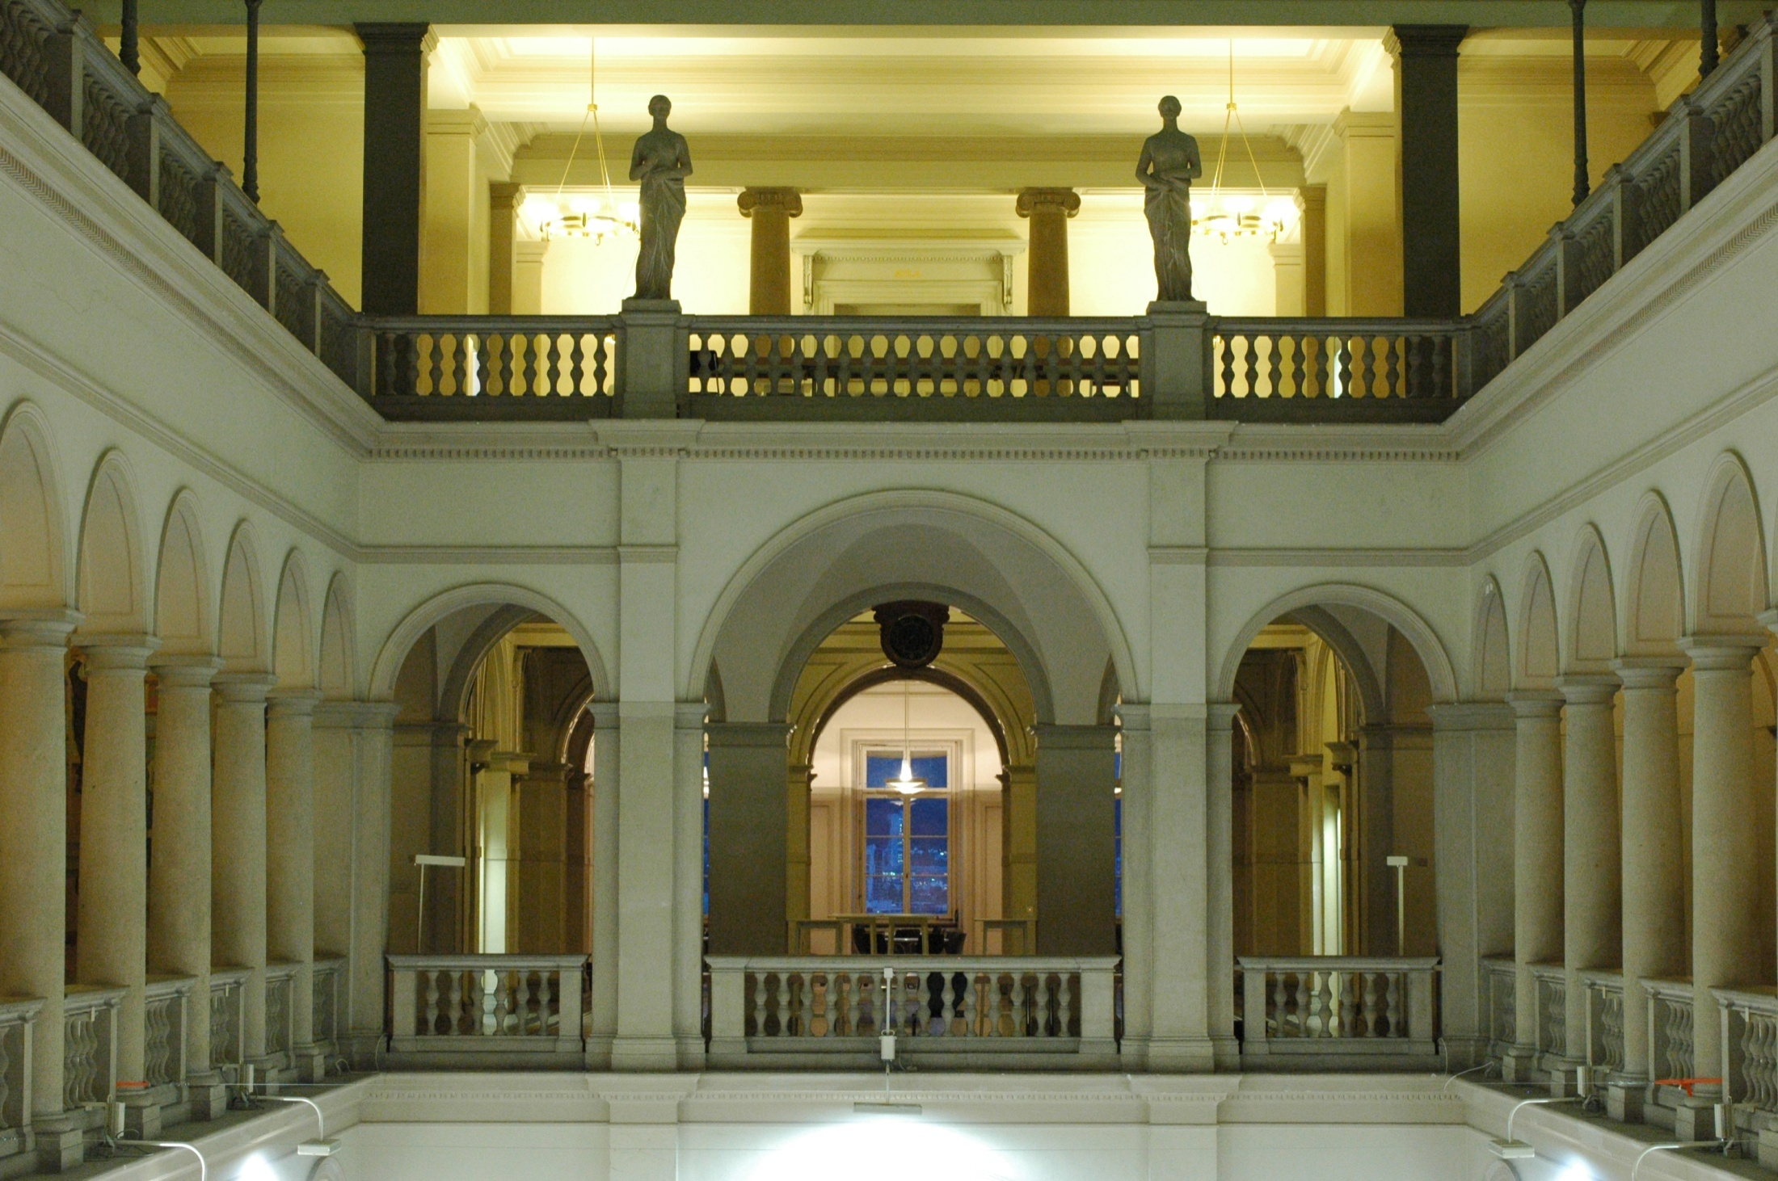
History and Focus of ETH Zurich
1855 founded as Federal Polytechnic School
1911 renamed into Swiss Federal Institute of Technology
Research and teaching in the following areas:
Engineering Sciences and architecture
Mathematics and natural sciences
21 Nobel Prize Laureates have studied, taught or carried out their research at ETH Zurich

Slide 11
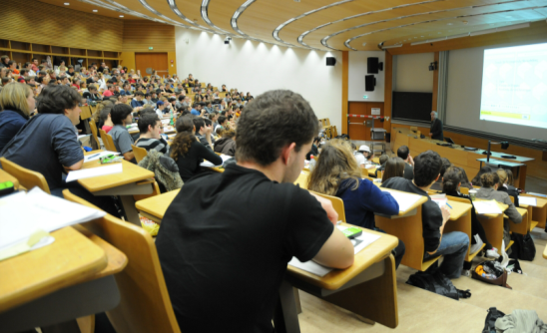
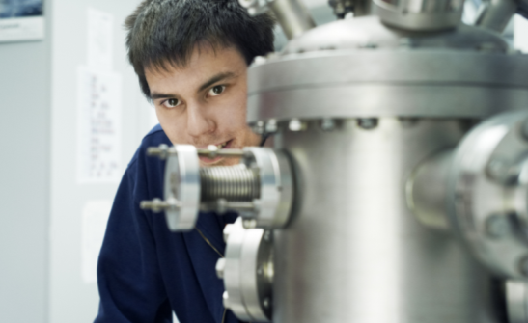
Facts of ETH Zurich
Study, research and work place of 20,000 people from 80 nations
16 Faculties
> 370 professors
> 9’000 employees
> 15’000 students
High supervision ratio 1:40
23 bachelor degree courses
39 master degree courses
> 1’000 bachelor diploma p.a.
> 1’300 master diploma p.a.
> 560 doctorate / PhD diploma p.a.
> 210 diploma in further education p.a.

Slide 12
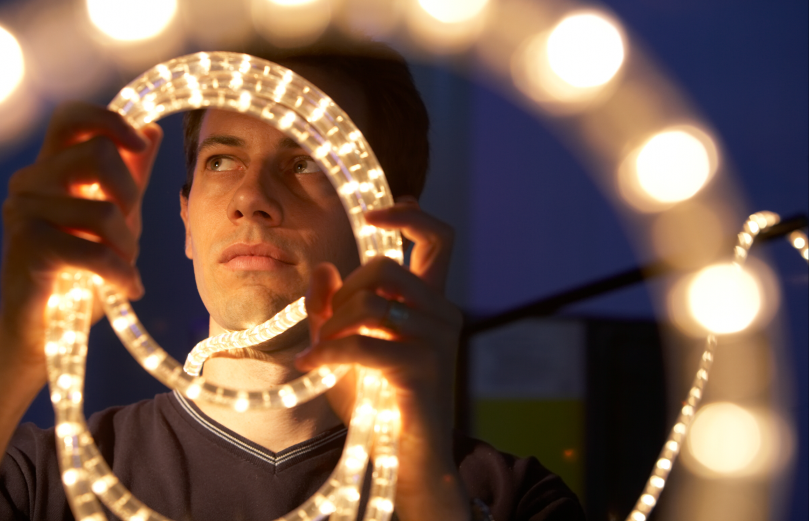
hope to See you all again in Zurich, Switzerland in 2011 for ISEC-06

